Slide 1
Social media

Slide 2
Smart city with social media
Usage of social media
Collect opinions (directly and indirectly)
Act engaging: sense of participation/belonging
Raise awareness (?)
Show locations with increased urban/cyberactivism
Instagram, Facebook, Twitter, Wordpress

Slide 3
Representation of data?
Map
Graph/diagram – ie change over time
Staples – key words (“Uppsala”)

Slide 4
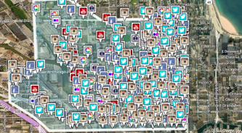

Slide 5
The Instagram API
You may subscribe to real-time updates from four basic Instagram object types:
Users: receive notifications when users who have registered with your application post new photos.
Tags: receive notifications when a new photo is tagged with tags of your choosing
Locations: receive notifications when new photos are posted and tagged with a specific location
Geographies: receive notifications when a new photos are posted in an arbitrary geographical location as defined by a center point and radius

Slide 6
Instagram API
You can get a lot of information
name, profile picture, bio etc
You need to register for this API
Seems promising, the documentaions seems good

Slide 7
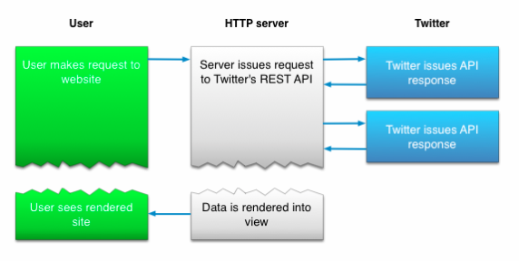
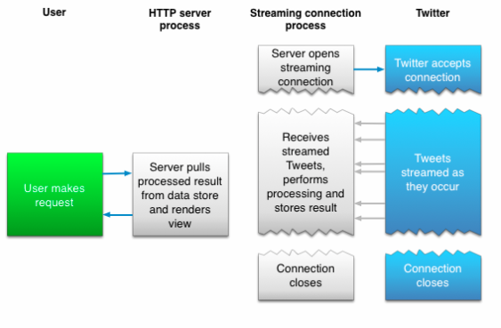
Twitter
Well described API at https://dev.twitter.com/overview/documentation
Two different approaches:
Search for Tweets
Stream Tweets in real time

Slide 8
Search
Search Tweets - relevance and not completeness
Data from the last week
Uses REST standard
Example request: https://api.twitter.com/1.1/search/tweets.json?q=%23Uppsala&src=typd
Returns something like:
{"errors":[{"code":215,"message":"Bad Authentication data."}]}
This is because your application needs to be authenticated, described in the API… xD

Slide 9
Stream
Tweet volume can change rapidly. The best practice for ingesting Tweets and other streaming messages is to decouple collection and processing of high volume streams
Need to think about how to effectively store and process the data
Example stream request: https://stream.twitter.com/1.1/statuses/filter.json?track=uppsala

Slide 10
Limitations
Rate limit. Limited number of requests per user and 15 minutes
Geographic Data. You will not (and will not allow others to) aggregate, cache, or store location data and other geographic information contained in the Content, except in conjunction with a Tweet to which it is attached. You may only use such location data and geographic information to identify the location tagged by the Tweet. Any use of location data or geographic information on a standalone basis or beyond the license granted herein is a breach of this Agreement.
What does this mean??

Slide 11
Bloggar?
Vår slutsats är att att exkludera bloggar då det inte finns nått unisont system för detta och kan därför bli svårt att finna data
Någon som har annat förslag för att finna data? Spåna eller hojta till!

